Slide 1
Resistance Poetry in a Decolonizing Africa
Lusophone (Portuguese-speaking) Africa
(a group of countries in West, Central, and Southern Africa:
Cabo Verde, São Tomé e Príncipe, Guinea-Bissau, Angola, Mozambique)
Represented by the collection of poems we read: When Bullets Begin to Flower, ed. Margaret Dickinson and published in 1972
South Africa (a single country, located on the southern tip
of the African continent)
Represented by the collection of poems we read: Poets to the People, ed. Barry Feinberg and published in 1974

Slide 2
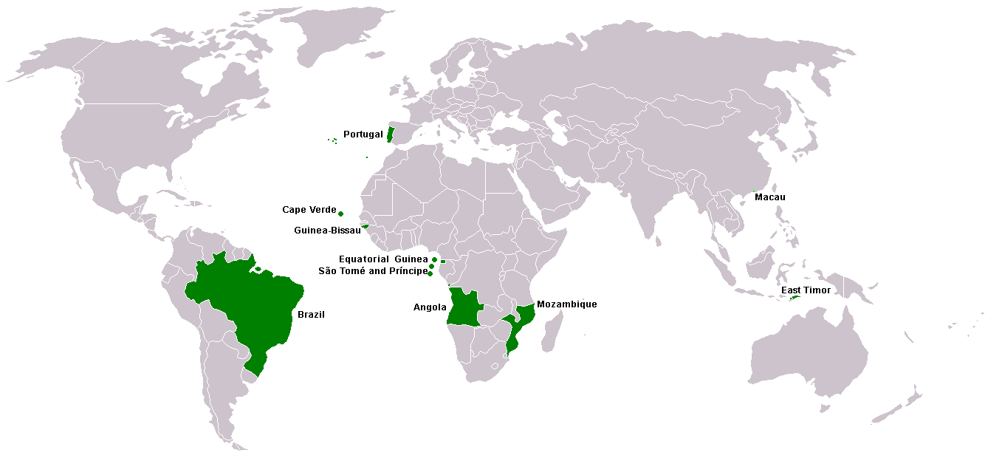
Map of the Lusophone world today. Today, the majority of speakers of Portuguese do not live in Portugal… Today, the majority live in Brazil – 8 of 10 speakers of Portuguese. It is estimated that by 2050, the majority of Portuguese speakers will live in Africa.

Slide 3
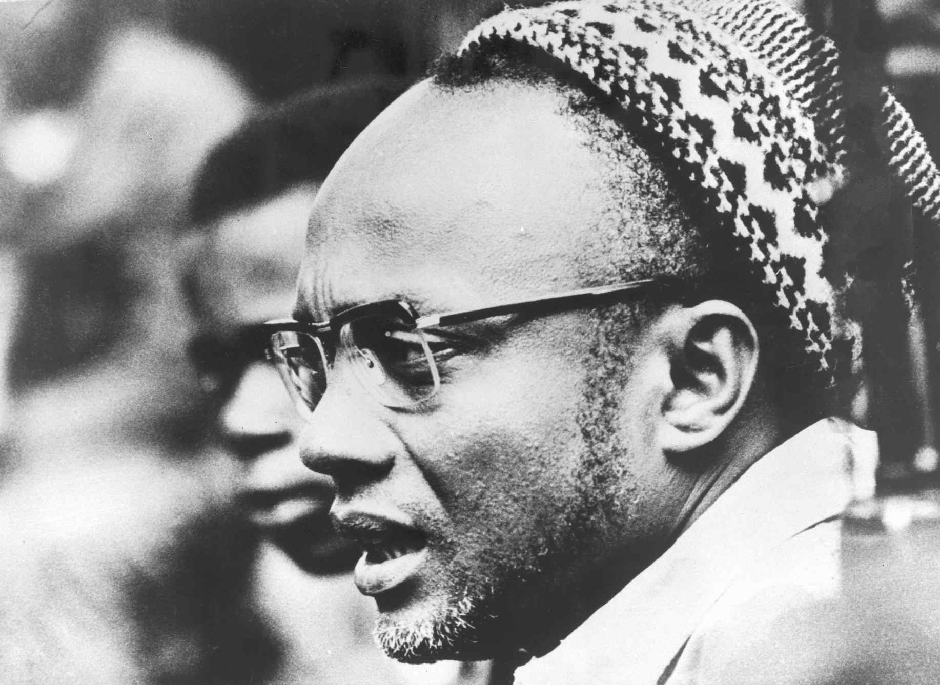
Amílcar Cabral,
Legendary anti-colonial leader in Lusophone Africa; founder of the PAIGC (Guinea-Bissau)

Slide 4
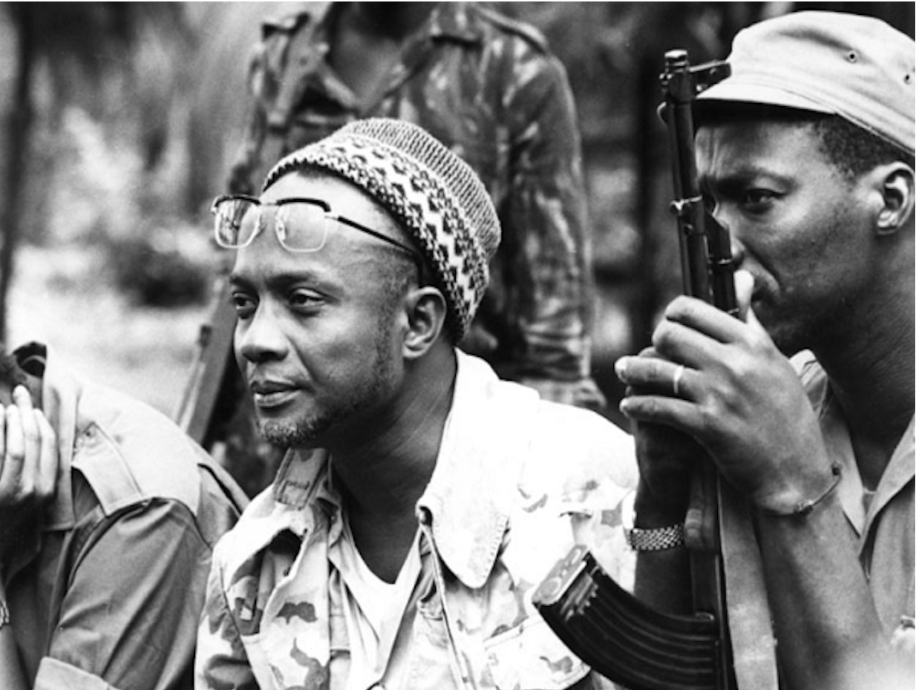

Slide 5
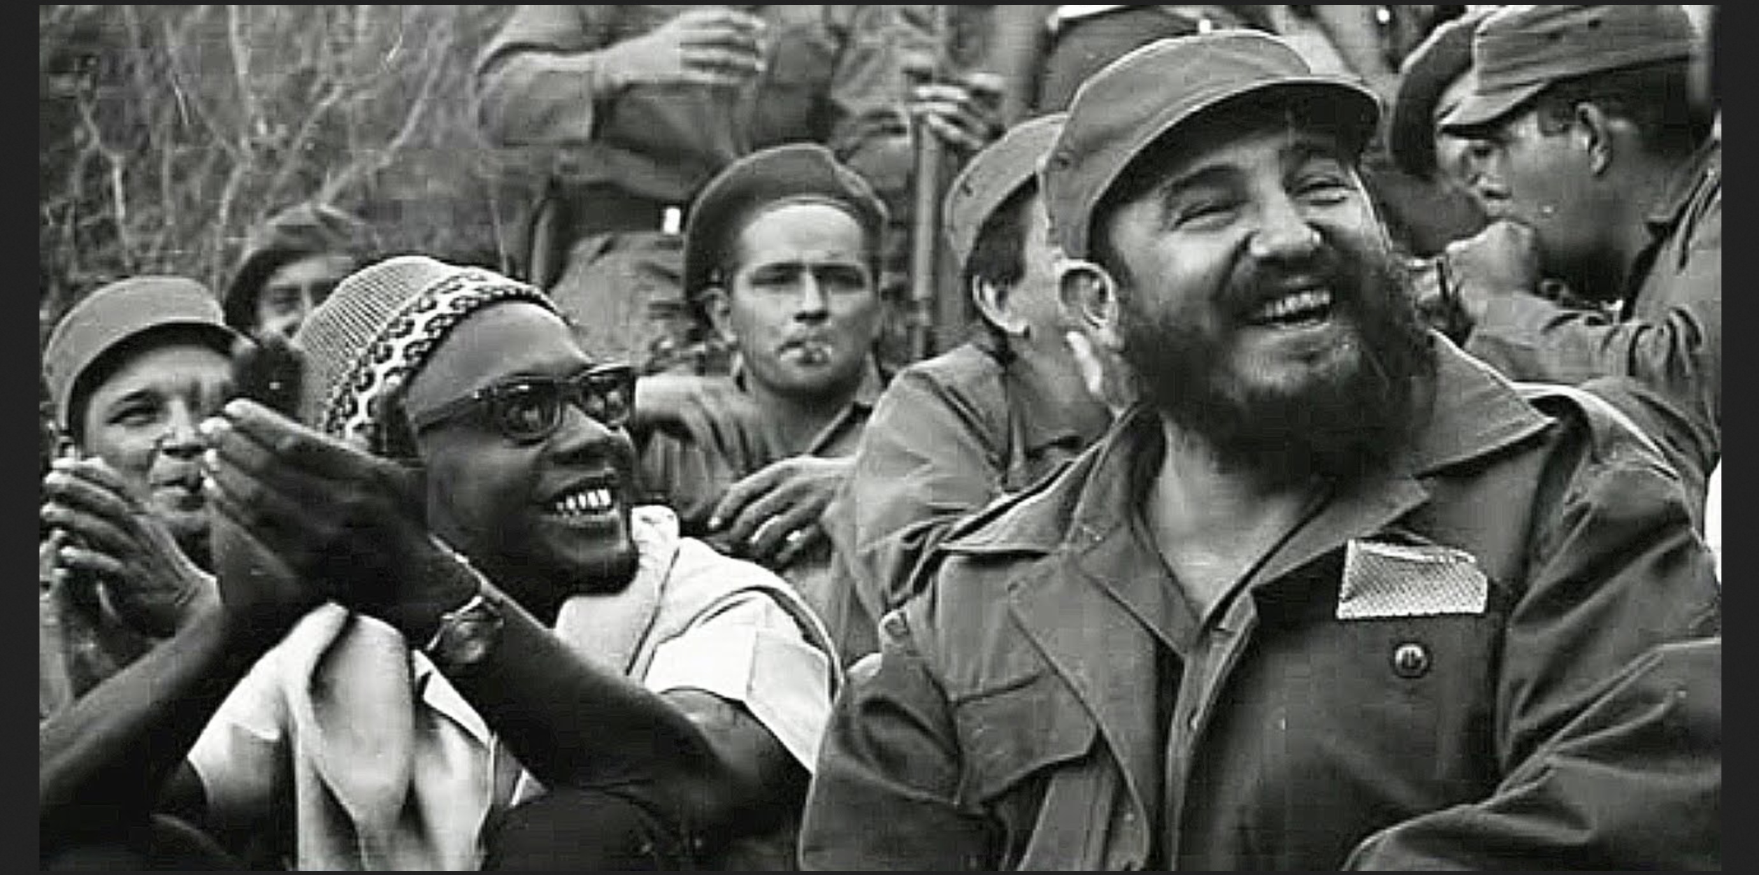

Slide 6
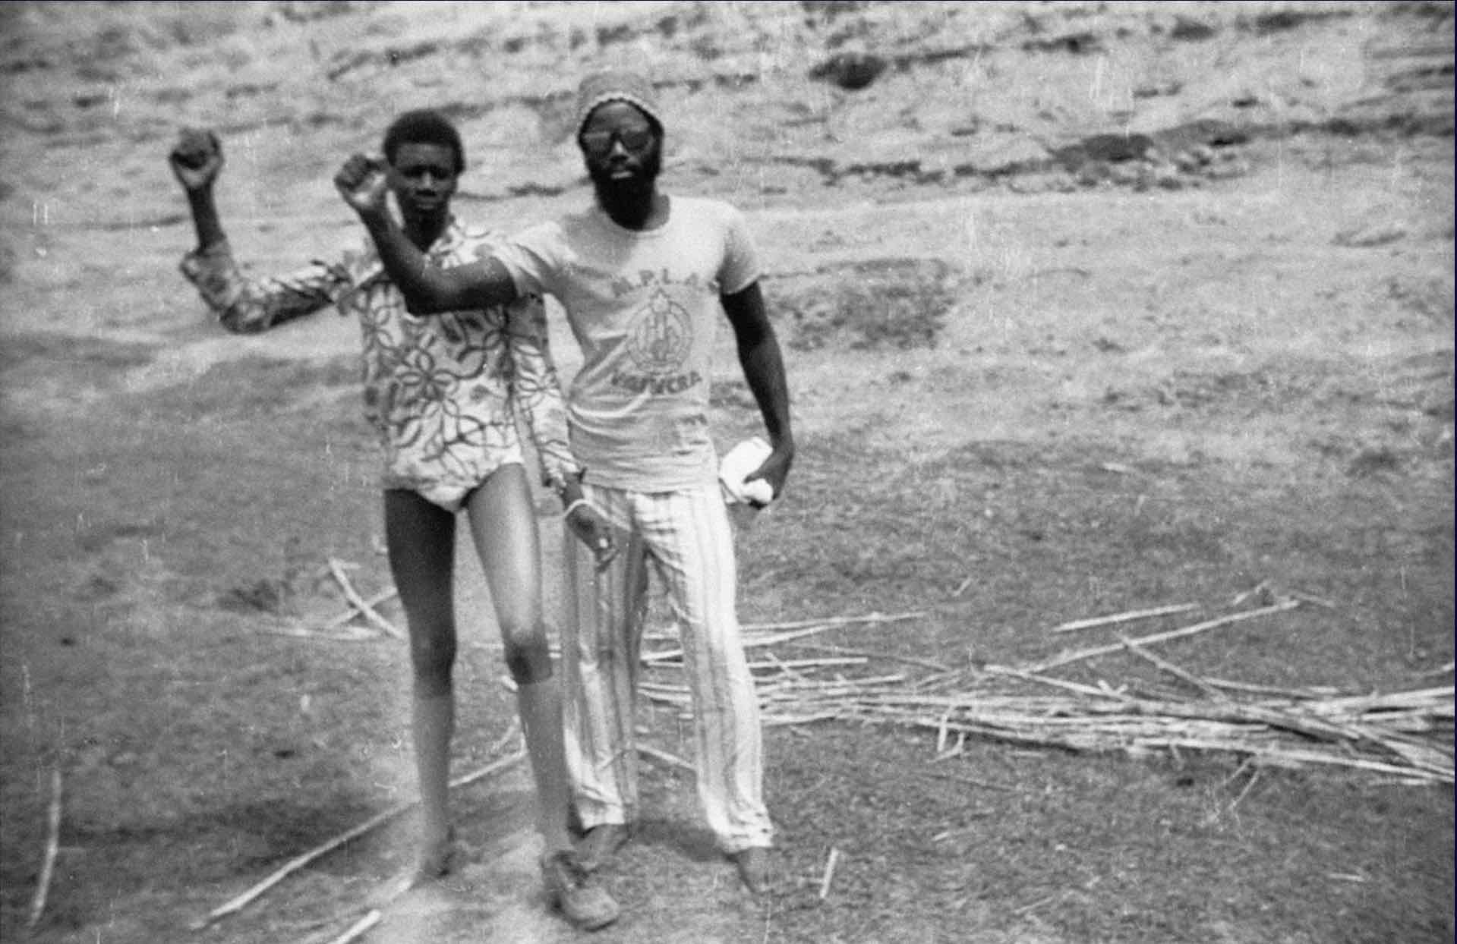
Photograph of Bouba Touré (at right) and friend in rural Mali. Touré was a Malian immigrants’ rights and labor activist who became involved in pan-African workers’ struggles while living as a migrant worker in Paris. Notice that he is wearing the ”Cabral” hat and an MPLA T-shirt as he (and his friend) raise their fists in a version of the “Black Power“ salute in Mali.

Slide 7
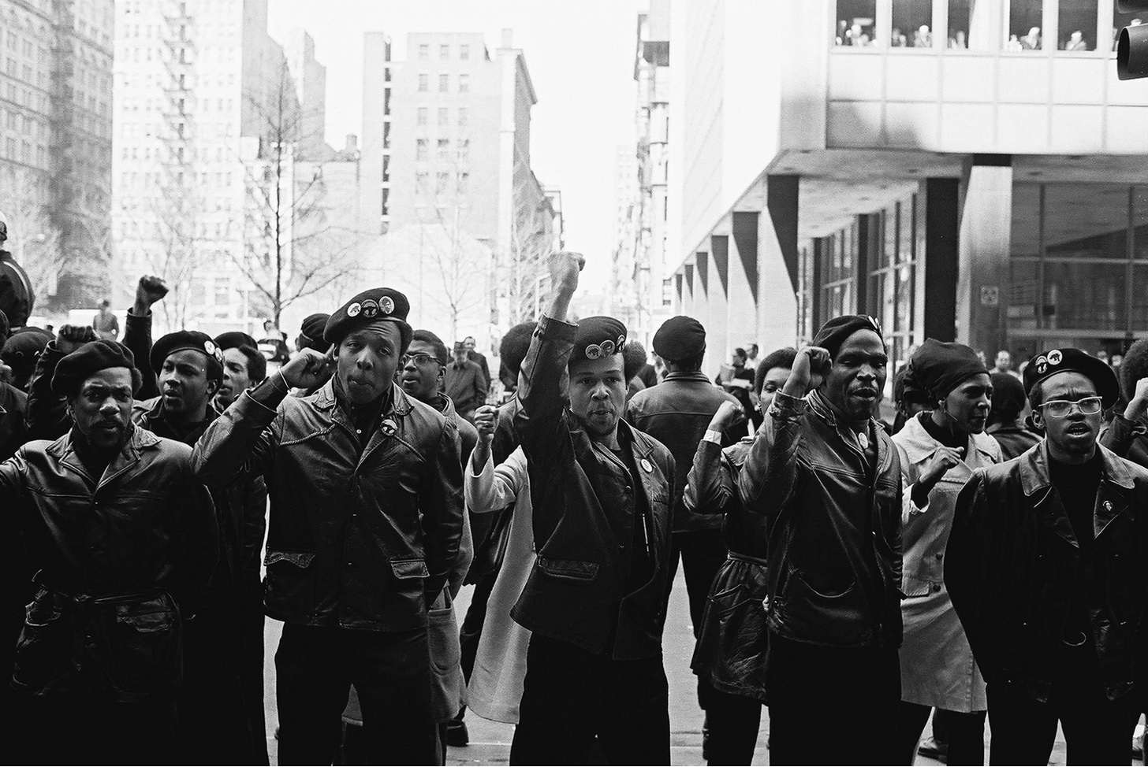
Black Panthers demonstrating in NYC in the 1970s (around the same time Touré’s photograph was taken in Mali)…

Slide 8
From Cabral’s 1965 speech in Dar es Salaam, called “The Nationalist Movements of the Portuguese Colonies” (Later published, posthumously published, in a book called The Revolution in Guinea, Stage 1)
“Our national liberation struggle has a great significance both for Africa and for the world. We are in the process of proving that peoples such as ours--economically backward, living sometimes almost naked in the bush, not knowing how to read or write, not having even the most elementary knowledge of modern technology--are capable, by means of their sacrifices and efforts, of beating an enemy who is not only more advanced from a technological point of view but also supported by the powerful forces of world imperialism. Thus before the world and before Africa we ask: were the Portuguese right when they claimed that we were uncivilised peoples, peoples without culture? We ask: what is the most striking manifestation of civilisation and culture if not that shown by a people which takes up arms to defend its right to life, to progress, to work and to happiness?”

Slide 9
Cabral’s 1965 speech in Dar es Salaam, continued (Slide 2)…
“In Africa we are for African unity, but we are for African unity in favour of the African peoples. We consider unity to be a means, not an end. Unity can reinforce and accelerate the reaching of ends, but we must not betray the end. That is why we are not in such a great hurry to achieve African unity. We know that it will come, step by Step, as a result of the fruitful efforts of the African peoples. It will come at the service of Africa and of humanity.
“In the CONCP we are firmly convinced that making full use of the riches of our continent, of its human, moral and cultural capacities, will contribute to creating a rich human species, which in turn will make a considerable contribution to humanity. But we do not want the dream of this end to betray in its achievement the interests of each African people. We, for example, in Guinea and Cabo Verde, openly declare in our Party's programme that we are willing to join any African people, with only one condition: that the gains made by our people in the liberation struggle, the economic and social gains and the justice which we seek and are achieving little by little, should not be compromised by unity with other peoples. That is our only condition for unity.
“In Africa, we are for an African policy which seeks to defend first and foremost the interests of the African peoples, of each African country, but also for a policy which does not, at any time, forget the interests of the world, of all humanity. We are for a policy of peace in Africa and of fraternal collaboration with all the peoples of the world.”

Slide 10
Cabral’s 1965 speech in Dar es Salaam, continued (Slide 3)…
“On an international level, we in the CONCP (Conference of Nationalist Organizations of the Portuguese Colonies) practice a policy of non-alignment. But for us non-alignment does not mean turning one's back on the fundamental problems of humanity and of justice. Non-alignment for us means not aligning ourselves with blocs, not aligning ourselves with the decisions of others. We reserve the right to make our own decisions, and if by chance our choices and decisions coincide with those of others, that is not our fault.”

Slide 11
Cabral’s 1965 speech in Dar es Salaam, continued (Slide 4)…
“We are with the refugees, the martyrised refugees of Palestine, who have been tricked and driven from their own homeland by the manoeuvres of imperialism. We are on the side of the Palestinian refugees and we support wholeheartedly all that the sons of Palestine are doing to liberate their country, and we fully support the Arab and African countries in general in helping the Palestinian people to recover their dignity, their independence and their right to live. We are also with the peoples of Southern Arabia, of so-called 'French Somaliland, of so-called 'Spanish' Guinea, and we are also most seriously and painfully with our brothers in South Africa who are facing the most barbarous racial discrimination. We are absolutely certain that the development of the struggle in the Portuguese colonies, and the victory we are winning each day over Portuguese colonialism is an effective contribution to the elimination of the vile, shameful regime of racial discrimination, of apartheid in South Africa. And we are also certain that peoples like that of Angola, that of Mozambique and ourselves in Guinea and Cabo Verde, far from South Africa, will soon, very soon we hope, be able to play a very important role in the final elimination of that last bastion of imperialism and racism in Africa, South Africa.”
Published on the Marxists’ Internet Archive:
https://marxists.architexturez.net/subject/africa/cabral/1965/tnmpc.htm

Slide 12
Discussion prompts… Pls. assign a spokesperson for your group to report back from your discussion. Pls. consider power dynamics and the “move up/move back” rule when assigning the spokesperson role. (In other words, do not give this role to the person for whom it comes most easily/naturally…)
In When Bullets Begin to Flower…
Look at Agostinho Neto’s two poems, “Western Civilization” and “African Poetry.” Explore and discuss: differences and similarities between them (language, style, structure, images, tone). Explore and discuss: how do they work together as a pair?
Look at Onéismo Silveira’s poem, “A Different Poem,” and Jorge Rebelo’s poem, “Poem.” What do these two poems want from, or claim for, poetry?

