Slide 1
Weems’s photographic practice, including but not limited to The Kitchen Table Series, constitutes a watershed moment and contribution to feminist conceptual practice.
Elements of that practice (which surges in the 1970s-1990s) include:
--centering women’s experience or that of other marginalized subjects, whether on the level of the photographic image (as the explicit subject/object of the photograph) or in some other way…
--decentering the “male gaze” (often also patriarchal, heteronormative, white or white-dominant, Eurocentric in its cultural codes and values, middle- or upper-class, VERY rarely working-class)…
--centering everyday experience…
--decentering the exceptional, the “decisive moment,” the singular, the monumental, the historic…
--using photography to explore/create narratives (through serial practice/the series, performance, the inclusion of fictional or poetic elements)…
--using photography to break down the binary between the subject/object of the photograph (the photographer and the photographed subject; the photographer and the spectator; the photographed subject and the spectator)… thus feminist practitioners were the first to routinely photograph themselves (whether in the mode of self-portraiture or in more fictive/narrative modes – e.g., playing a character)

Slide 2
Cindy Sherman (begins working in the 1970s at Hallwalls in Buffalo, as part of a punk/post-punk
movement that was predominantly male…; her work in some ways directly contests the masculine/macho approach of many of the Hallwalls artists while also embracing the interest in post-punk aesthetics, pop culture engagements, and decenterings of author-genius narratives)
The series titled _Untitled Film Stills_ (they are not actual film stills) was shot in the late 1970s and early 1980s and continues to be one of her most renowned and frequently-cited works…

Slide 3
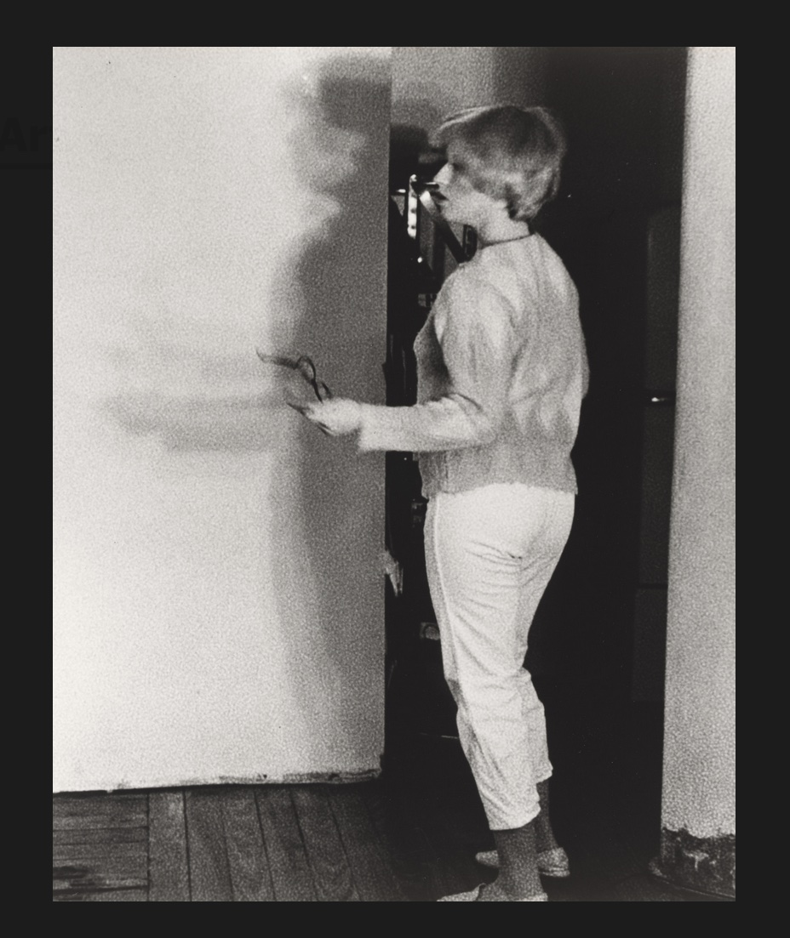

Slide 4
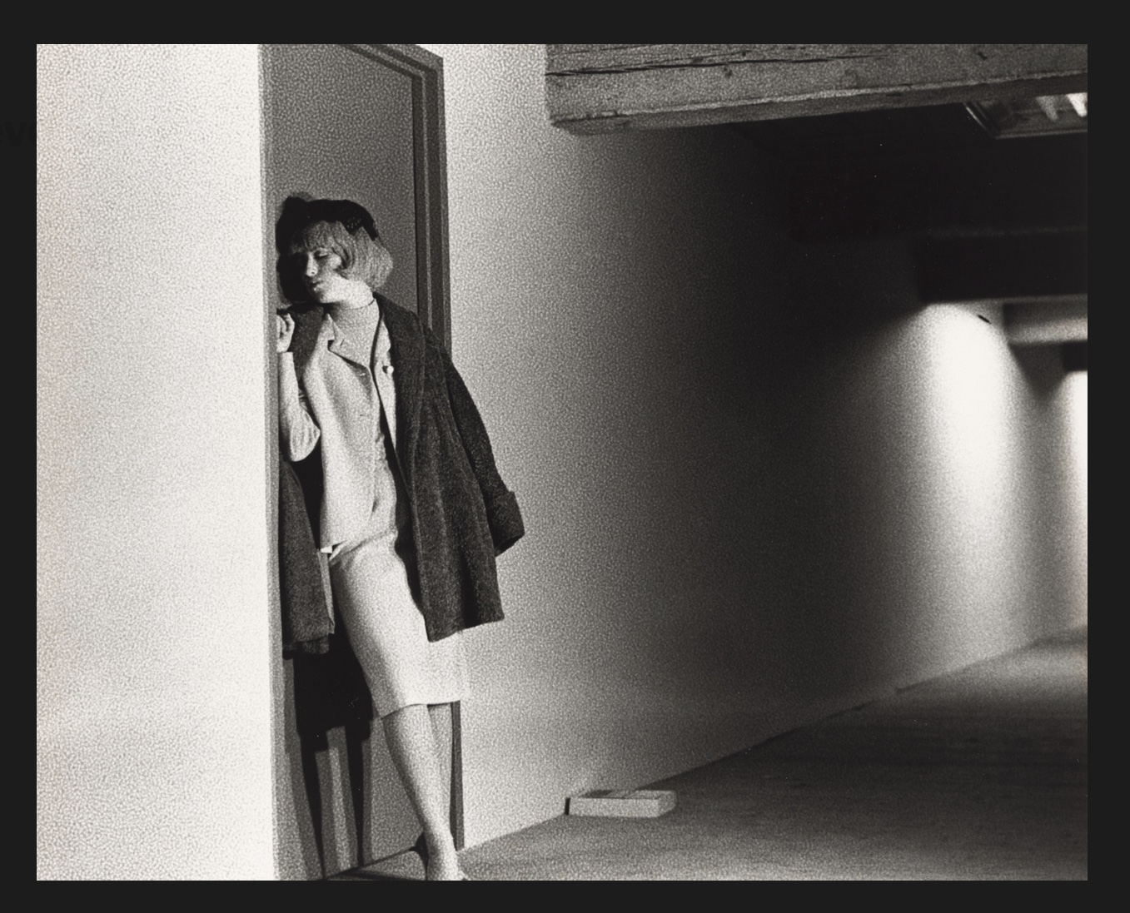

Slide 5
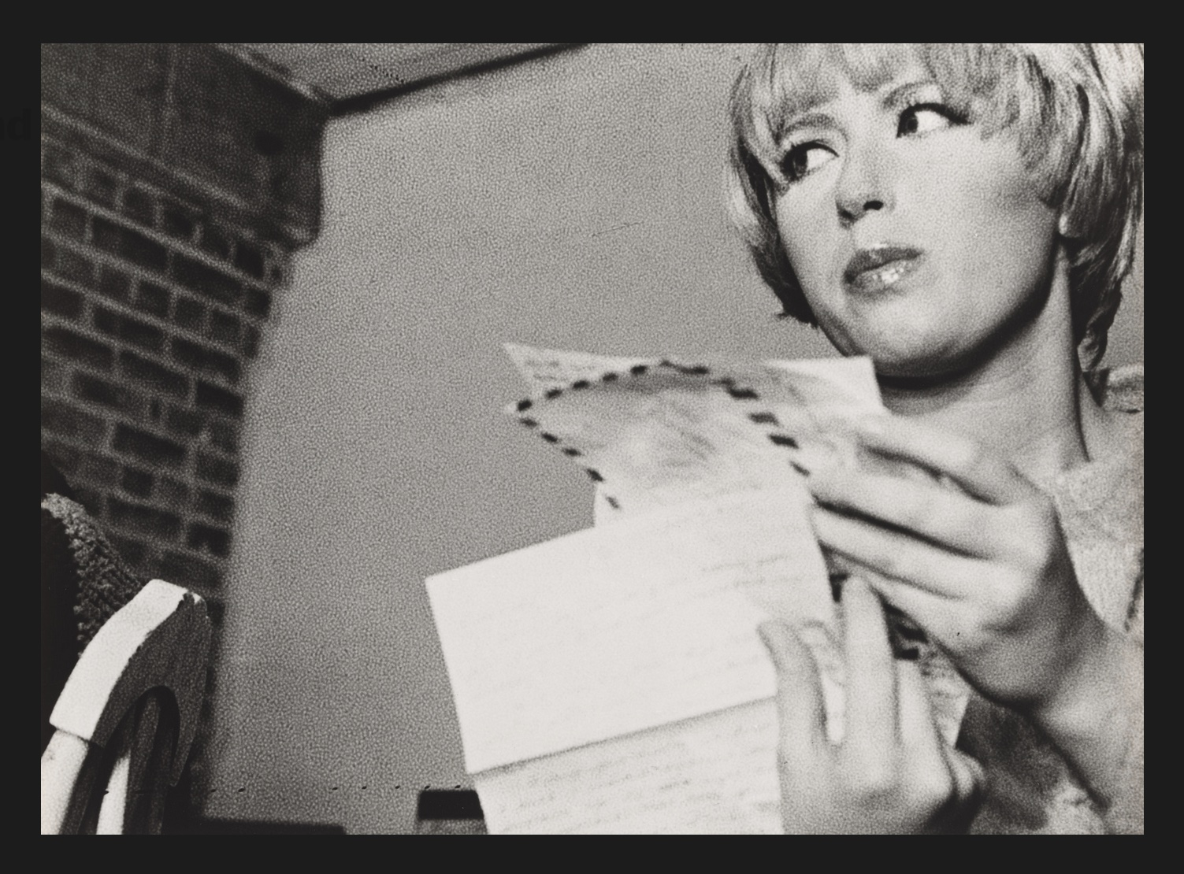

Slide 6
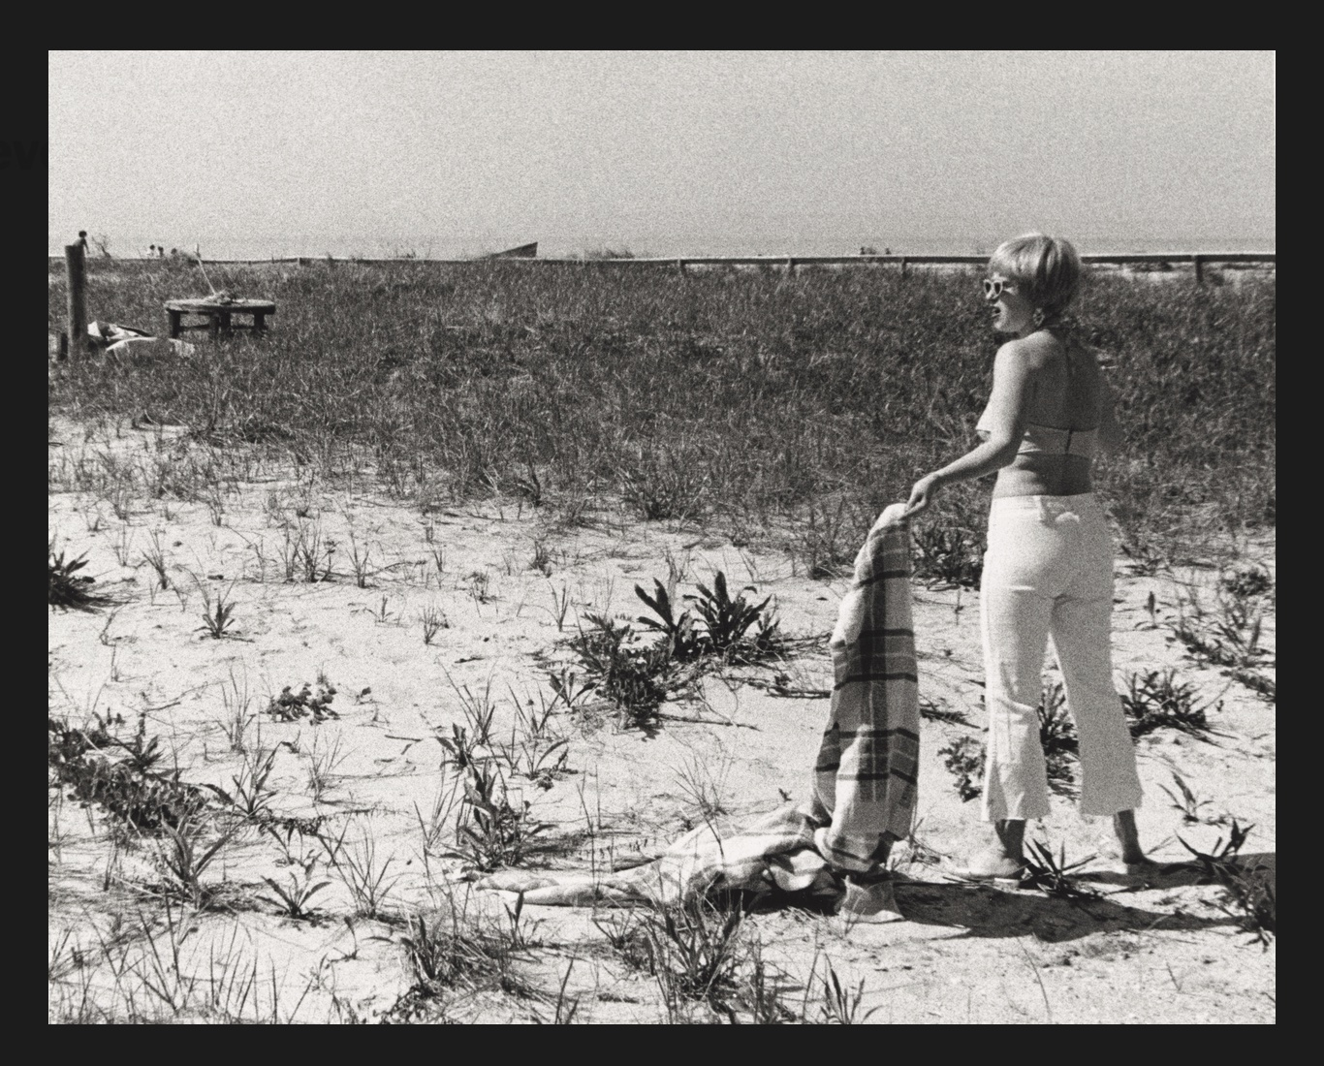

Slide 7
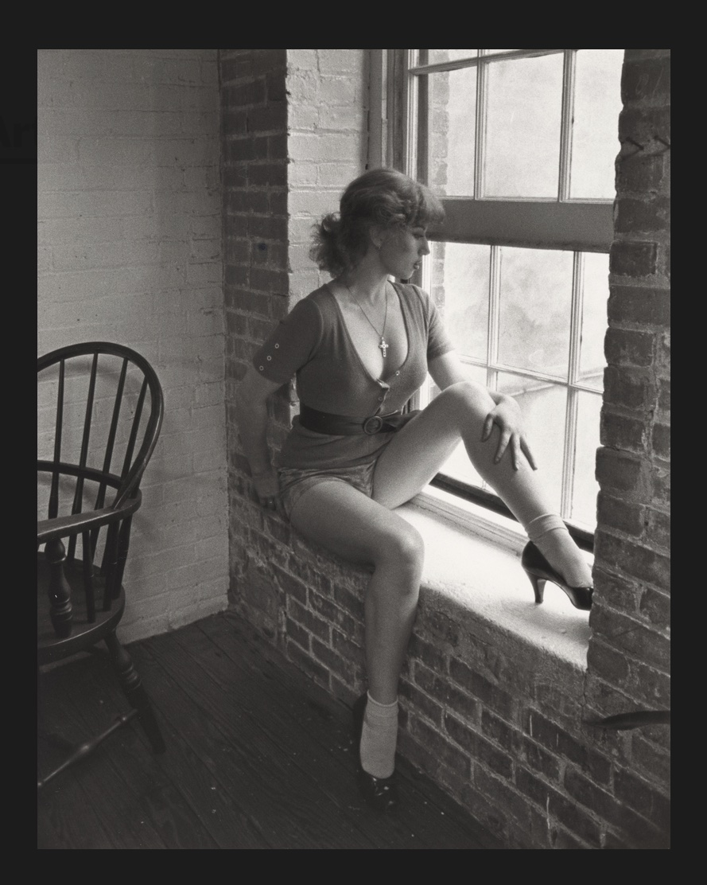

Slide 8
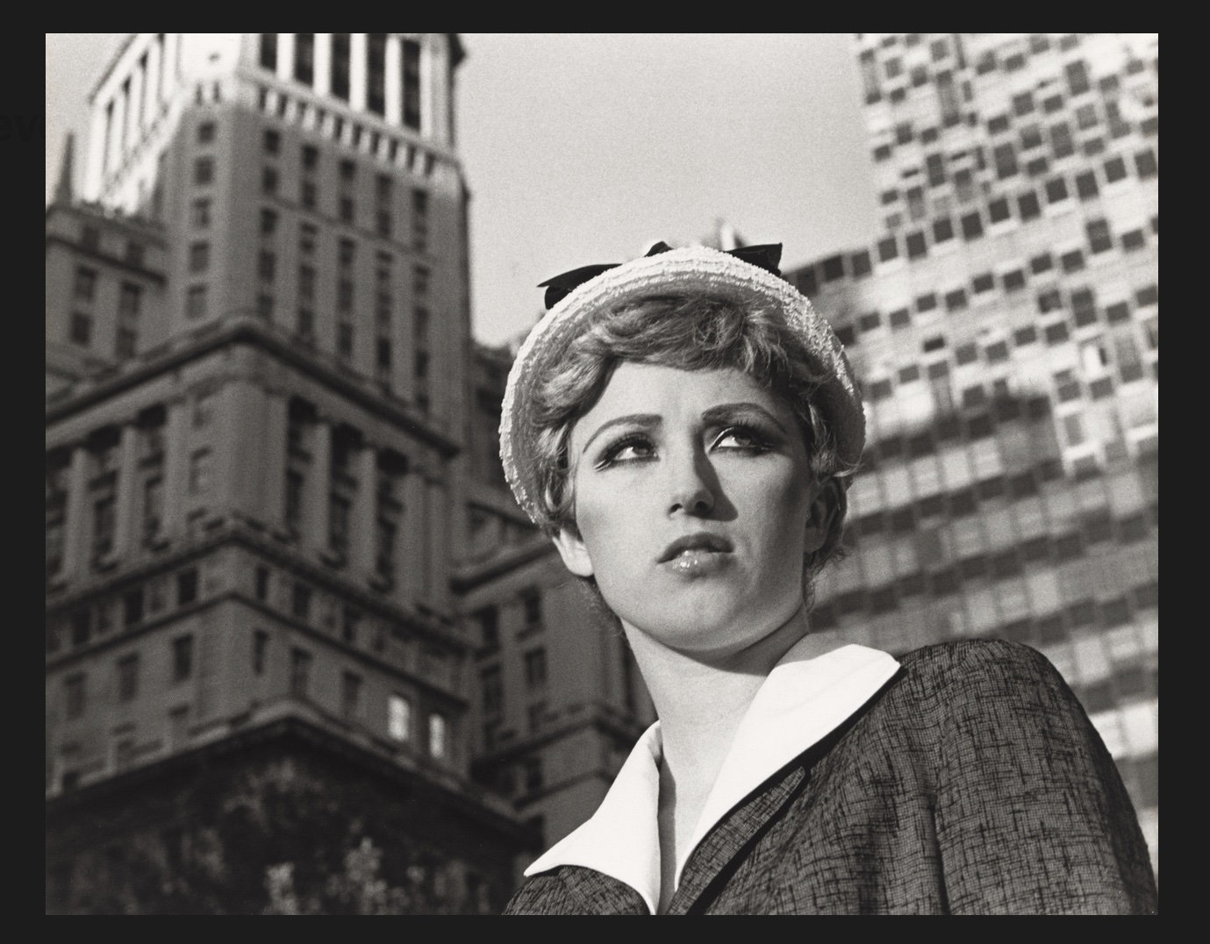

Slide 9
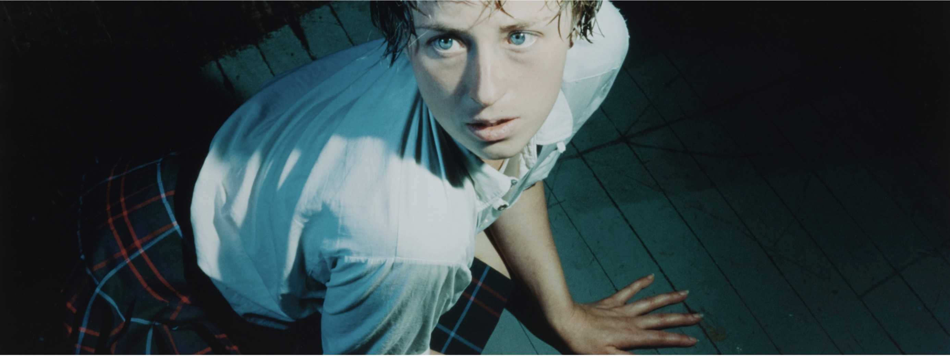

Slide 10
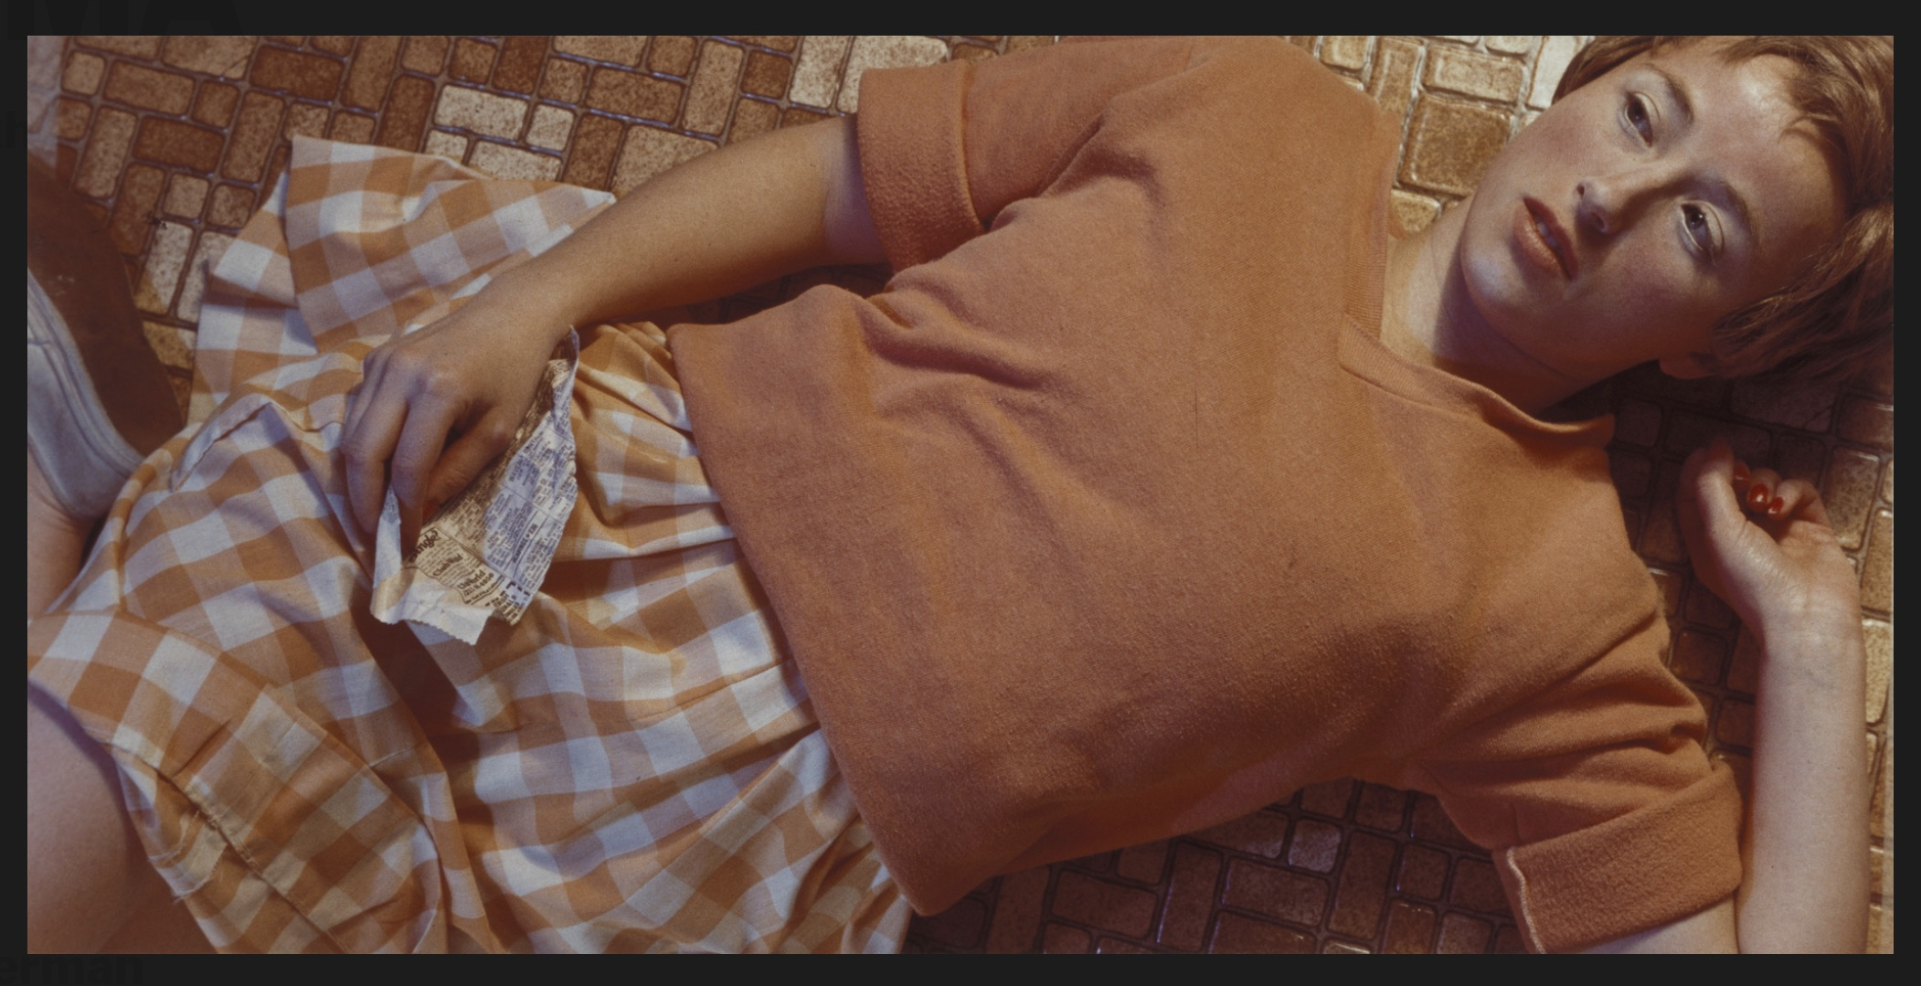

Slide 11
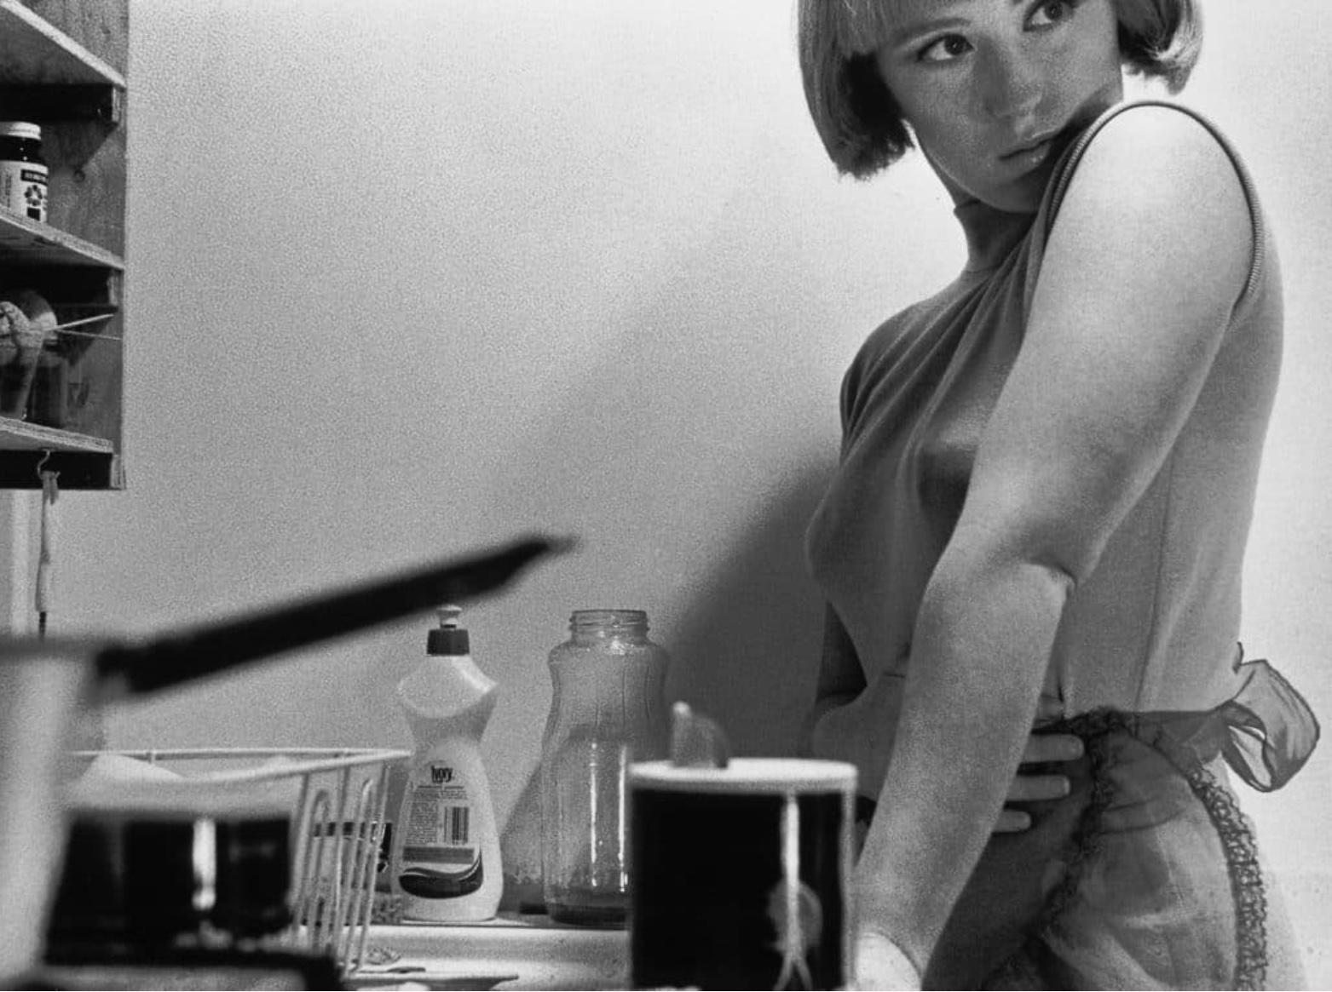

Slide 12
Nan Goldin (begins working professionally in Boston in the 1970s: her first exhibition of photographs takes place in Boston in 1973; her earliest photographs focus on gay/lesbian and trans communities and their corresponding nightlife subcultures in the 1970s; after moving to New York she begins projecting photographs of her friends in a screening-type/performance-type format at pop-up events around the city; she and many of friends become fixtures of the “downtown” scene)
Goldin’s most famous series of photographs, _The Ballad of Sexual Dependency_ is first developed as a projection event/performance and is ultimately published as a book in 1986; (in)famous for depicting drug use and its impact on her friends/community (later, herself) as well as sex, non-normative sex, or sex and sexual relations interrogated from the perspective of a gaze that is NOT the dominant/normative male gaze, _The Ballad of Sexual Dependency_ also includes self-portraits of Goldin showing the aftermath of being beaten up by her boyfriend; these images ultimately had a major impact in the art world – from which she was excluded for decades…

Slide 13
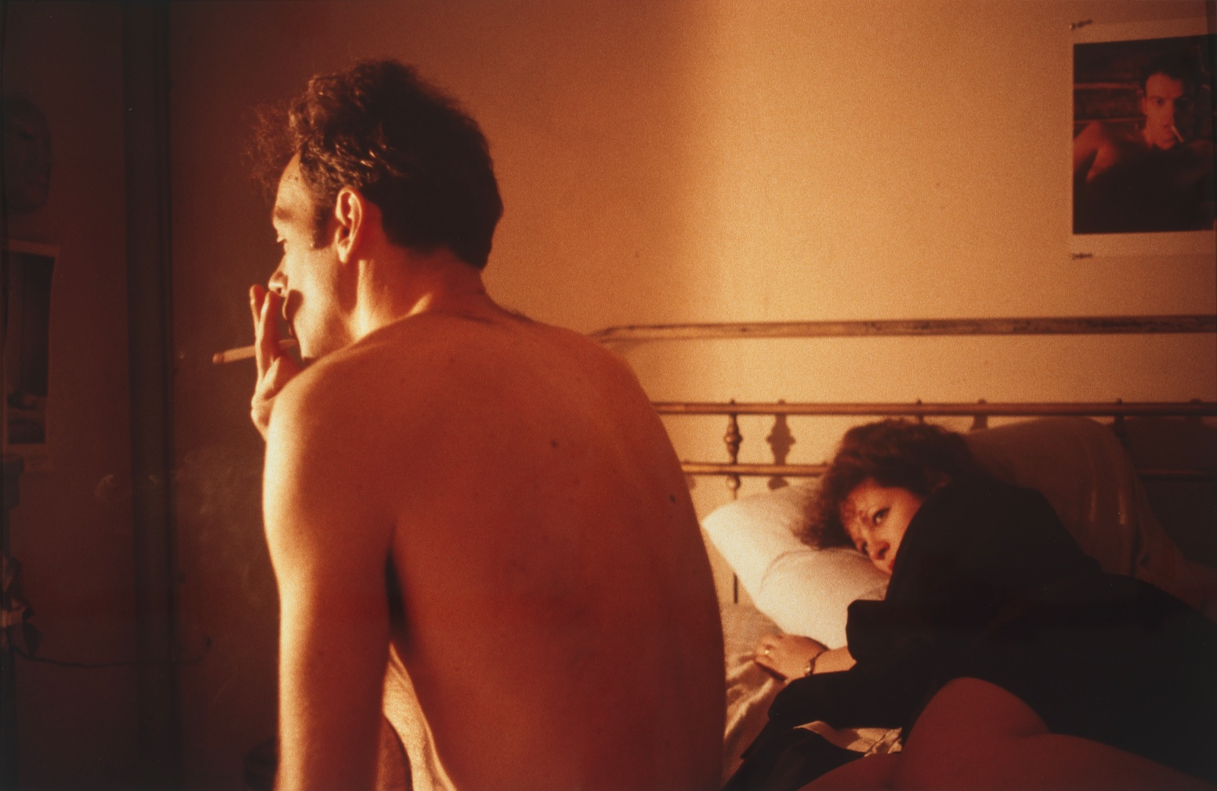

Slide 14
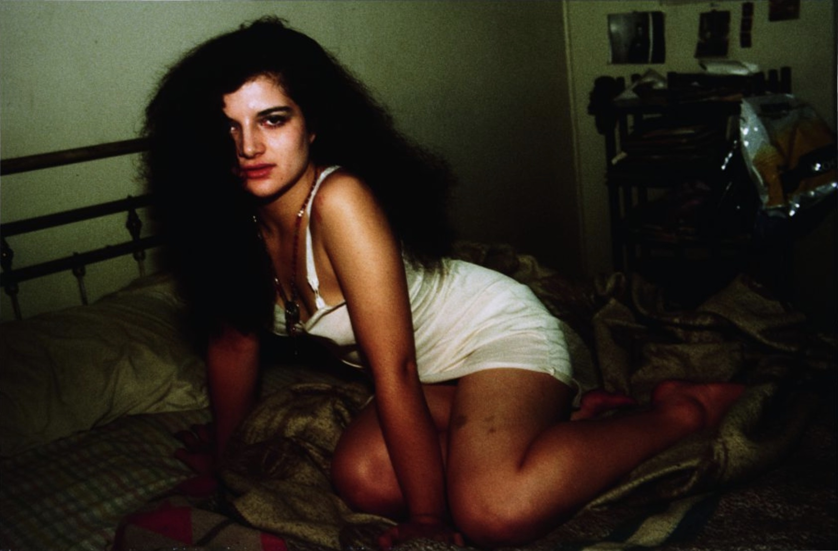

Slide 15
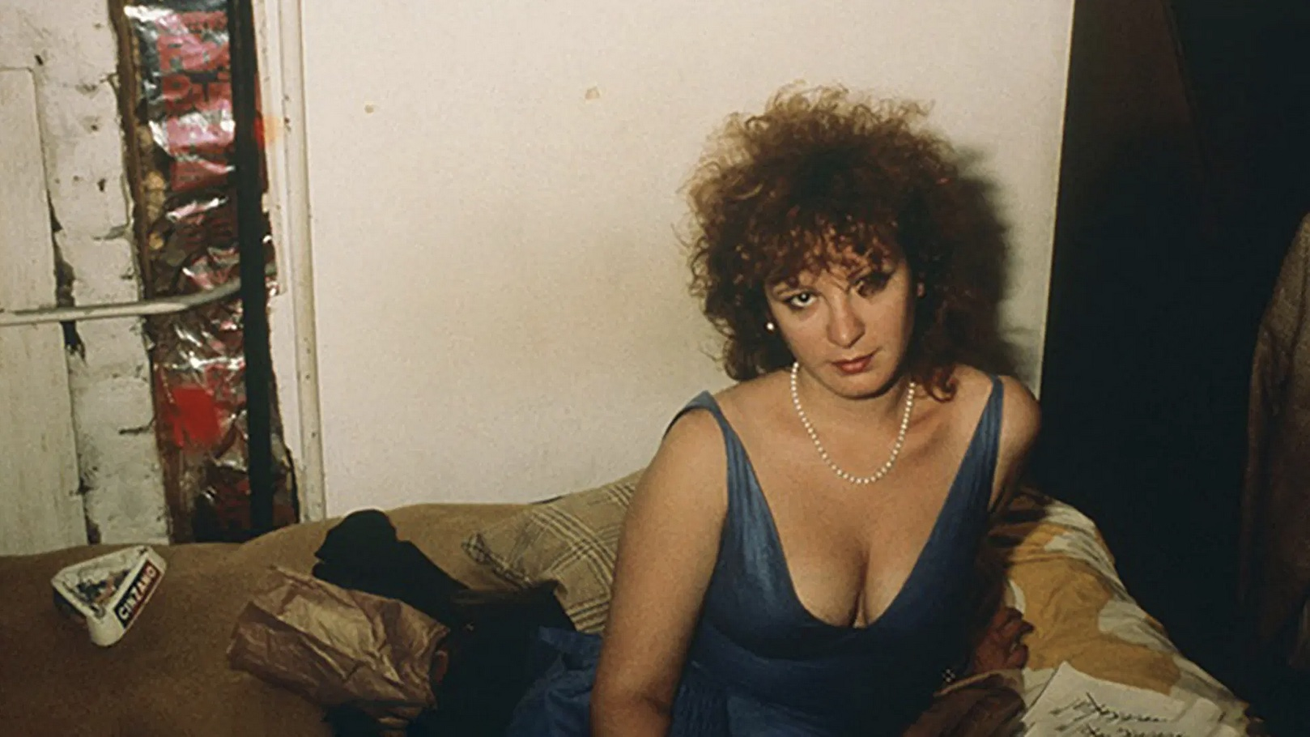

Slide 16
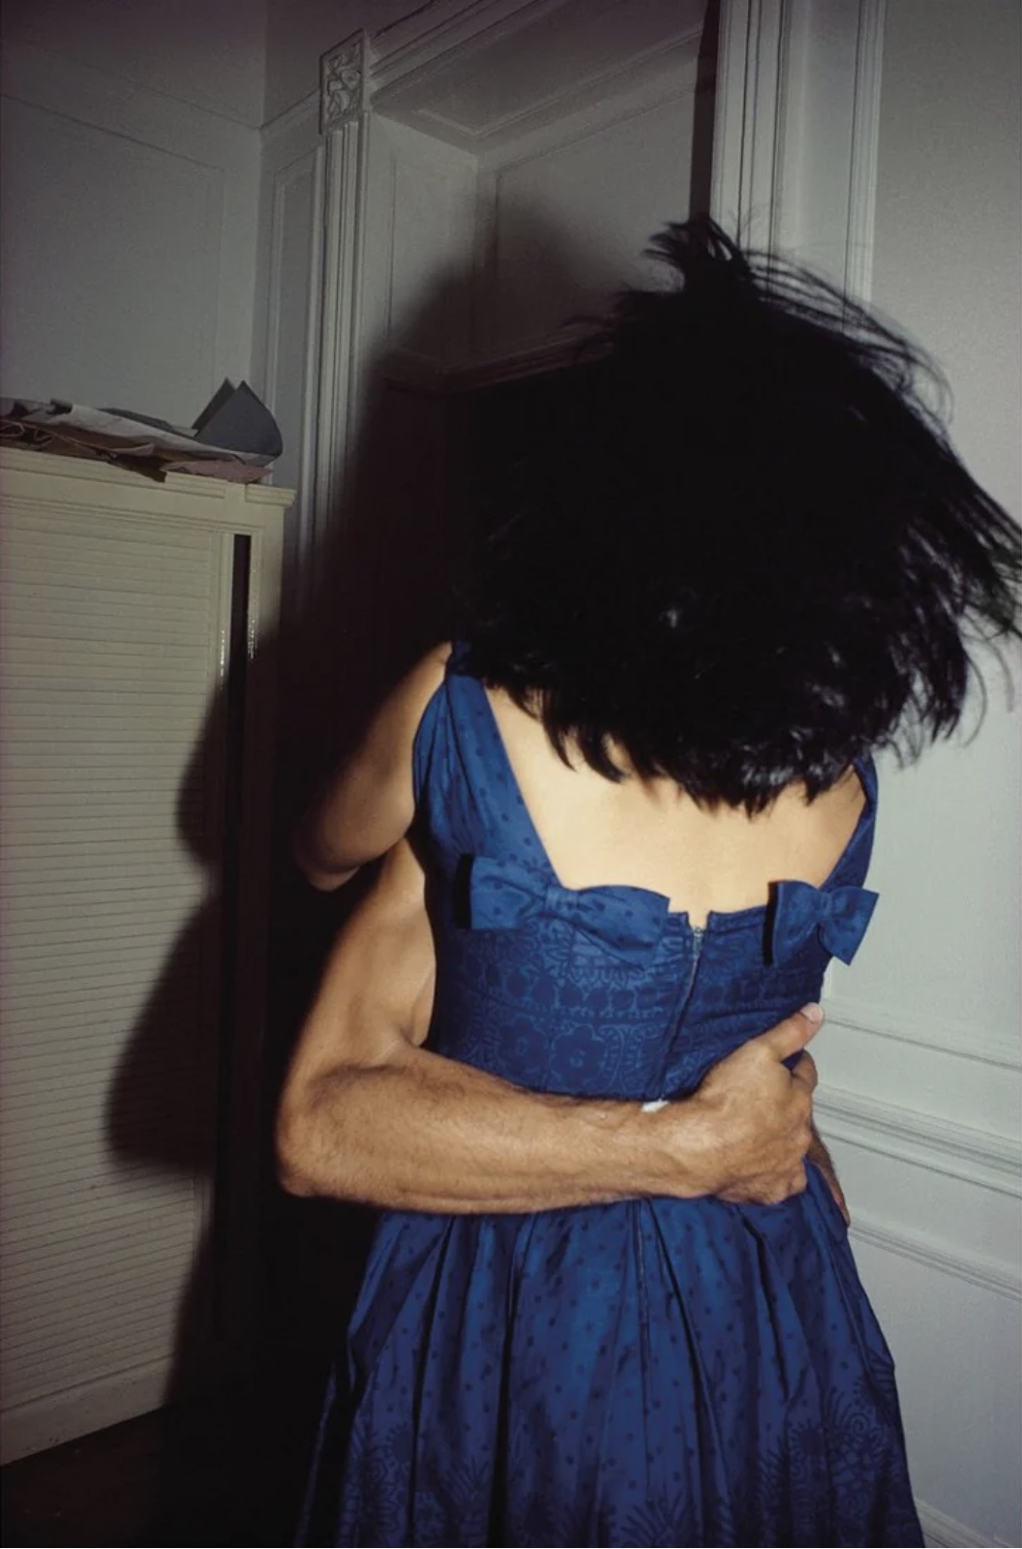

Slide 17
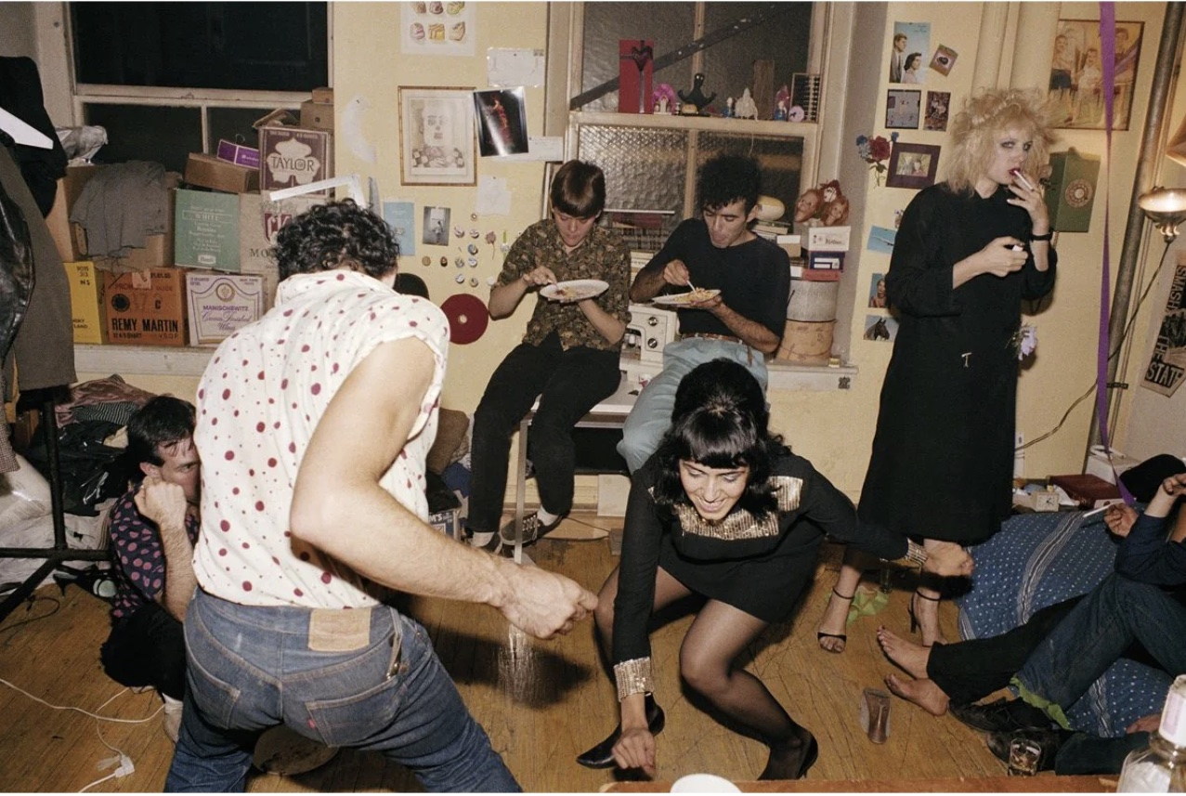

Slide 19
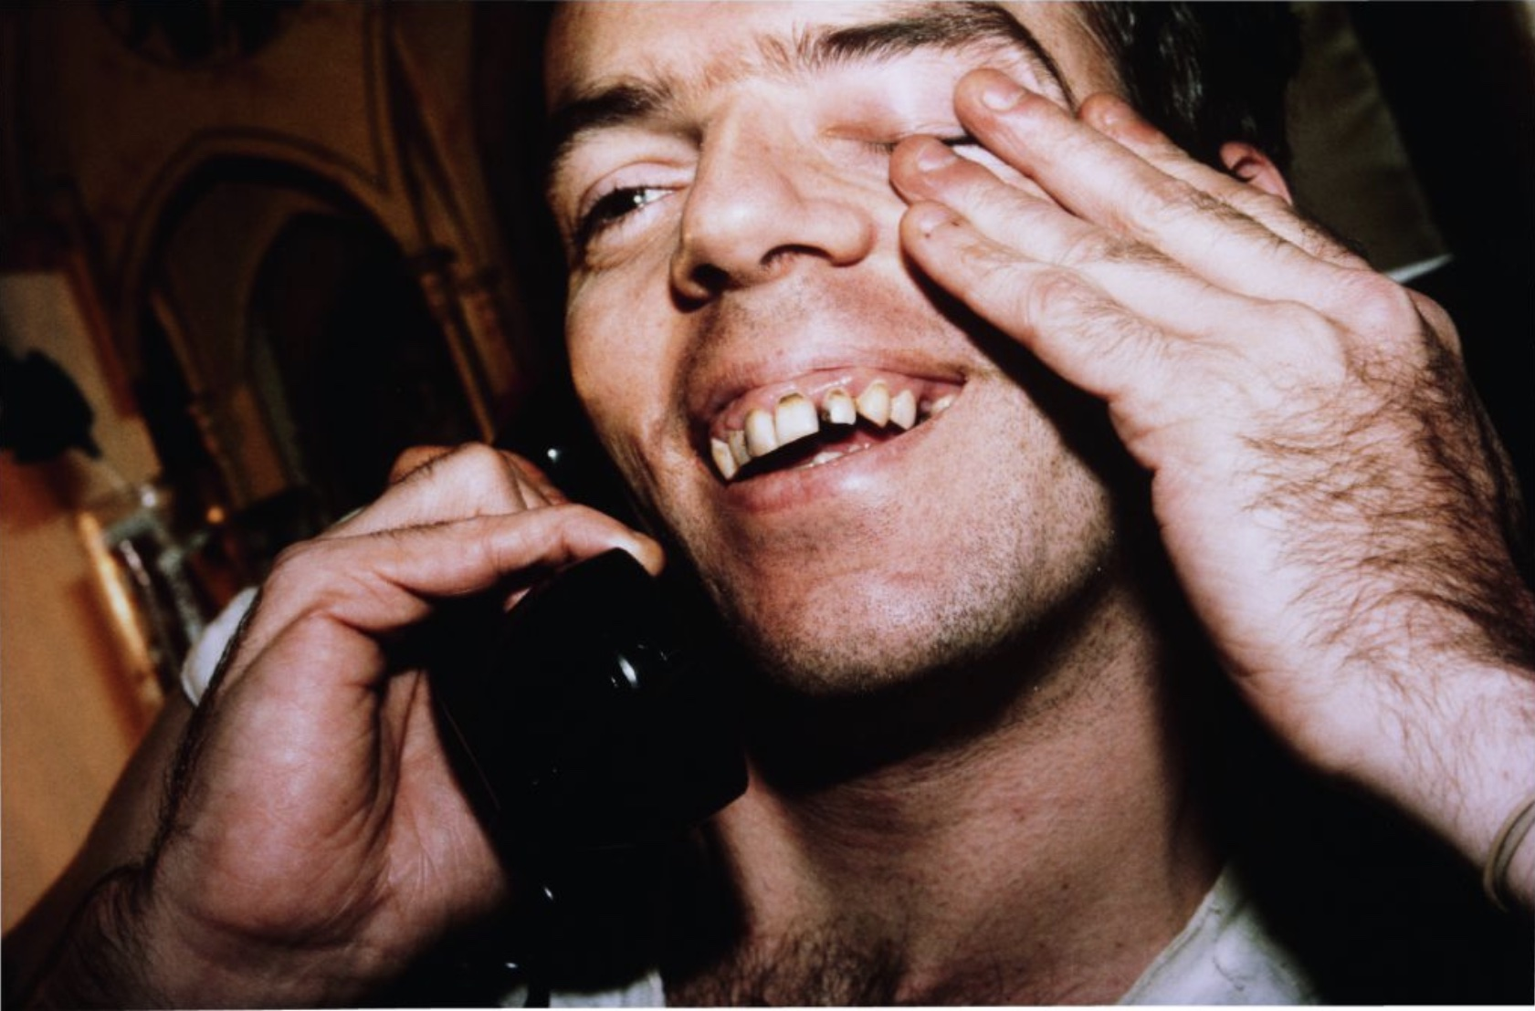

Slide 20
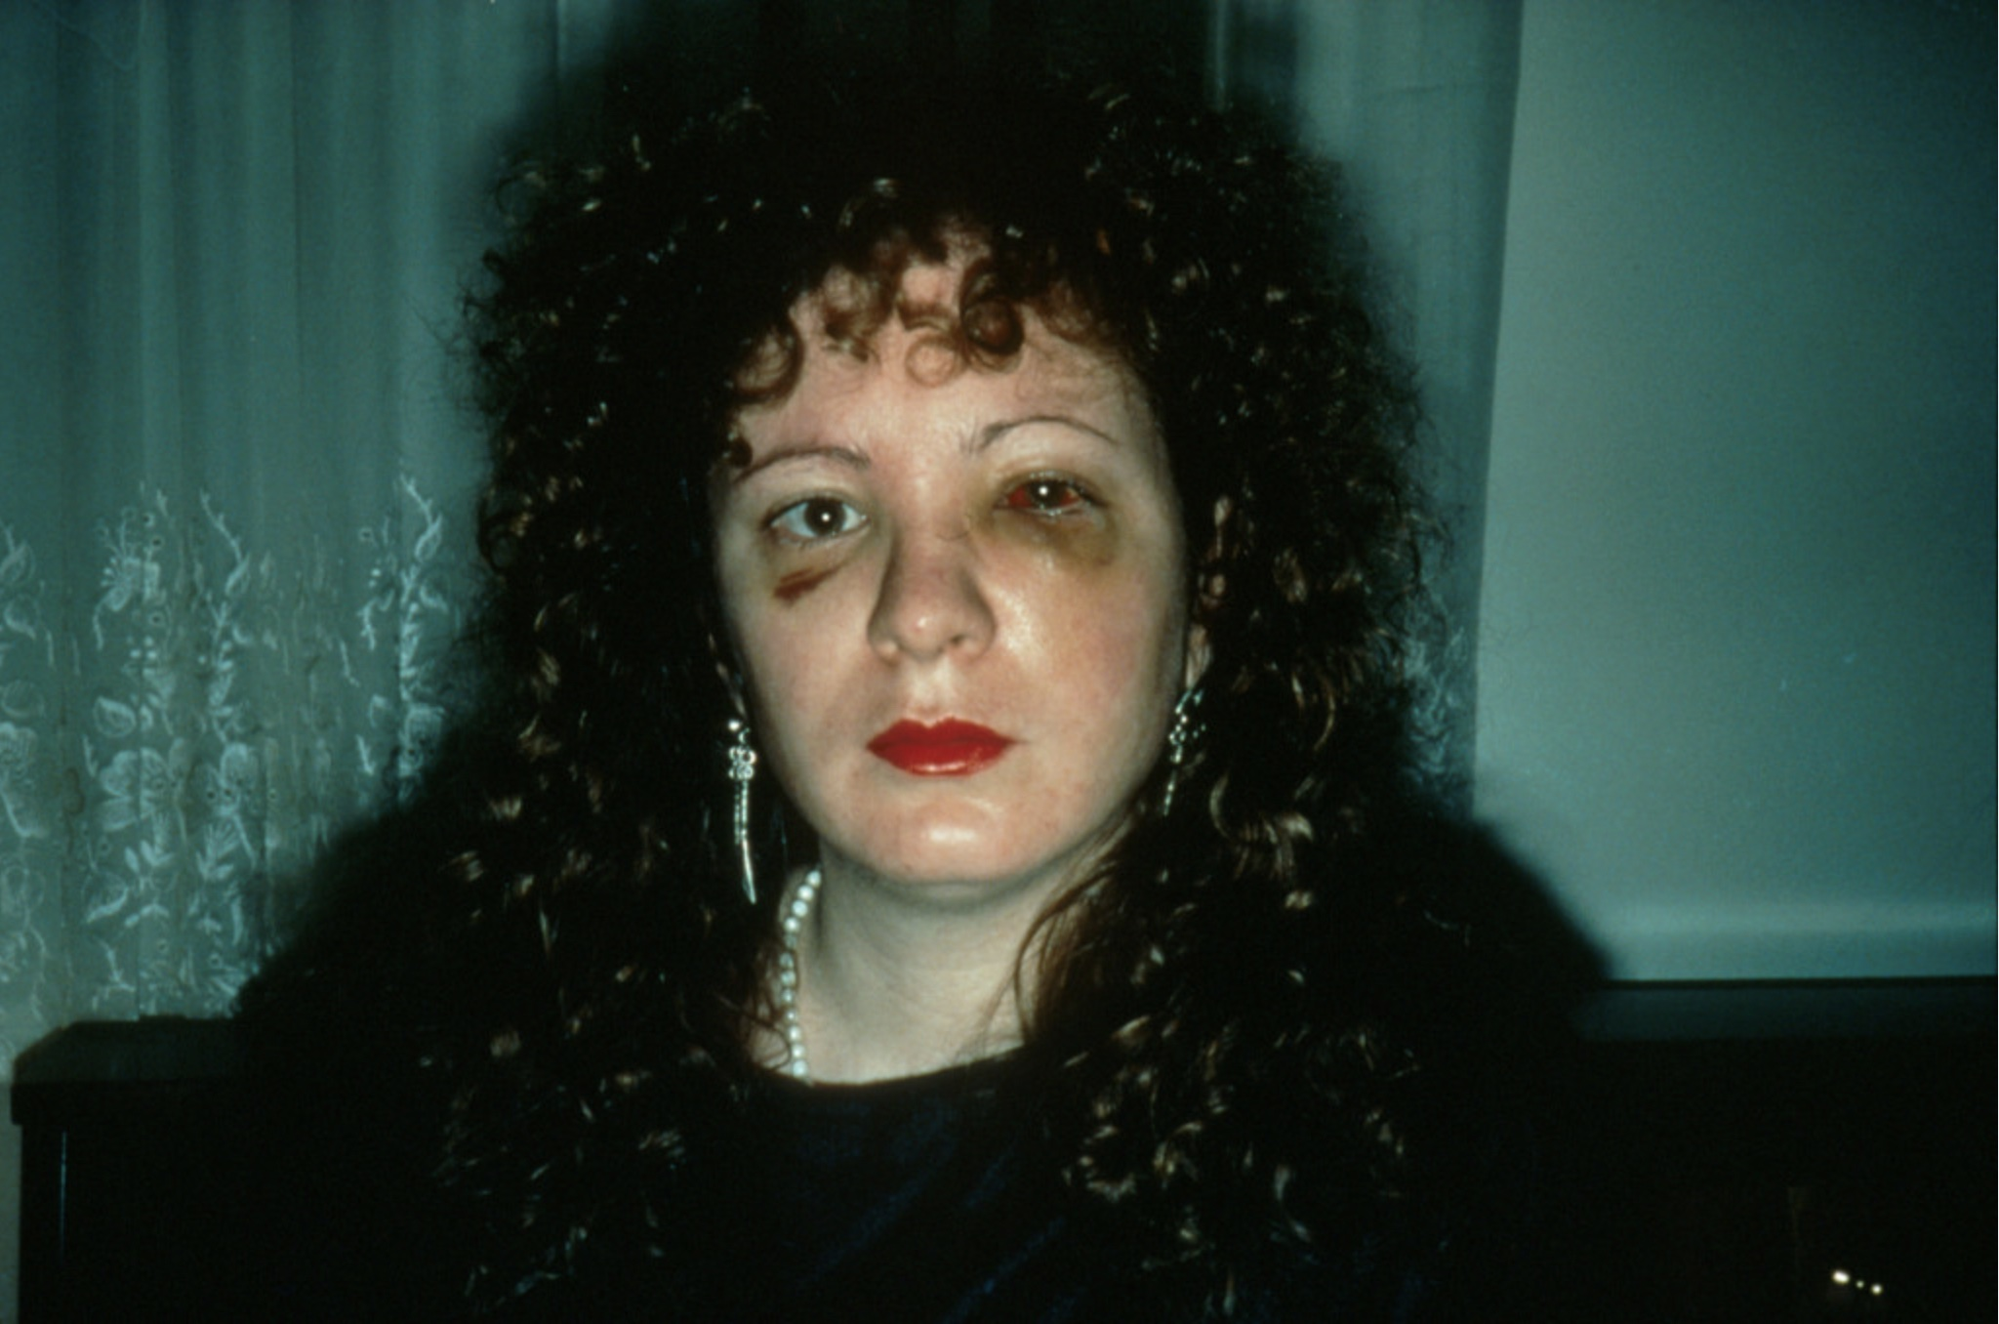

Slide 21
Moyra Davey (Canadian, working in NY since 1988: her work is distinguished for its powerful combinations of photography with video and writing; or for embracing what we call photography “in the expanded field”)
She is another photographer (like Goldin) who has really challenged the precious materiality of the photograph as a print on paper; as something that will be framed; as something that has a single iteration or form… Rather, she folds her photographs up, mails them around the world, writes on them, pins them to walls, displays them with wrinkles and holes and the markings that become apparent through and after their hyper-circulations.
Notice that, unlike Carrie May Weems, Cindy Sherman, or Nan Goldin, Davey does not tend to use her own body or her own image within the visual frame as part of her feminist toolkit. This is with the exception of her earliest work (when she was focused on portraiture/self-portraiture).

Slide 22
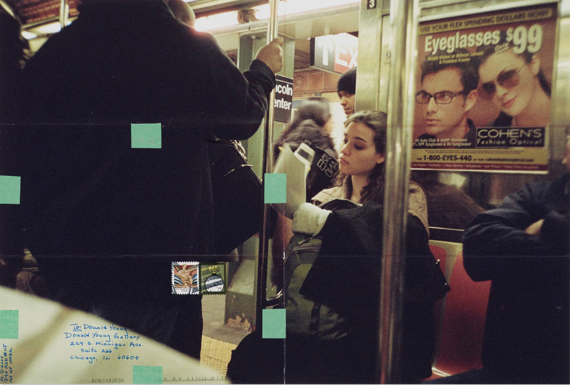

Slide 23
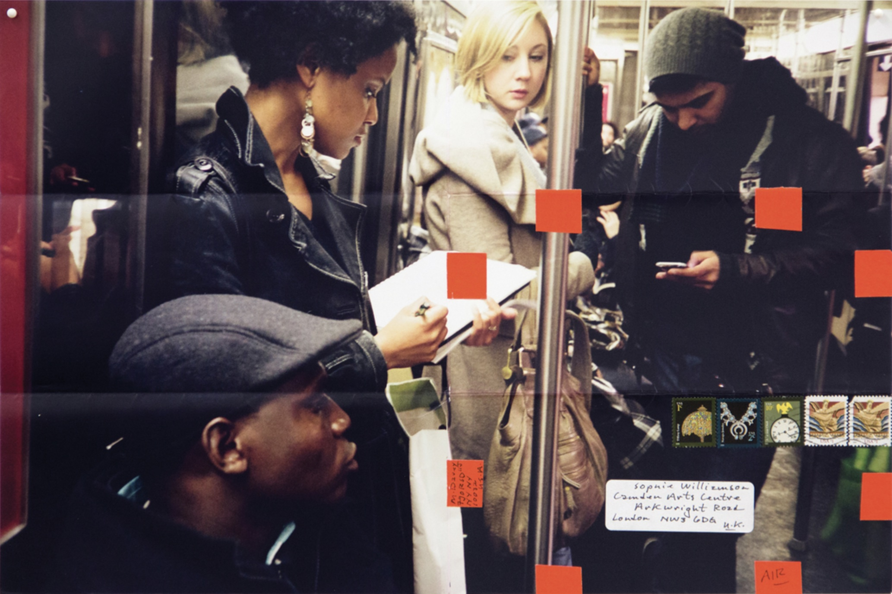

Slide 24
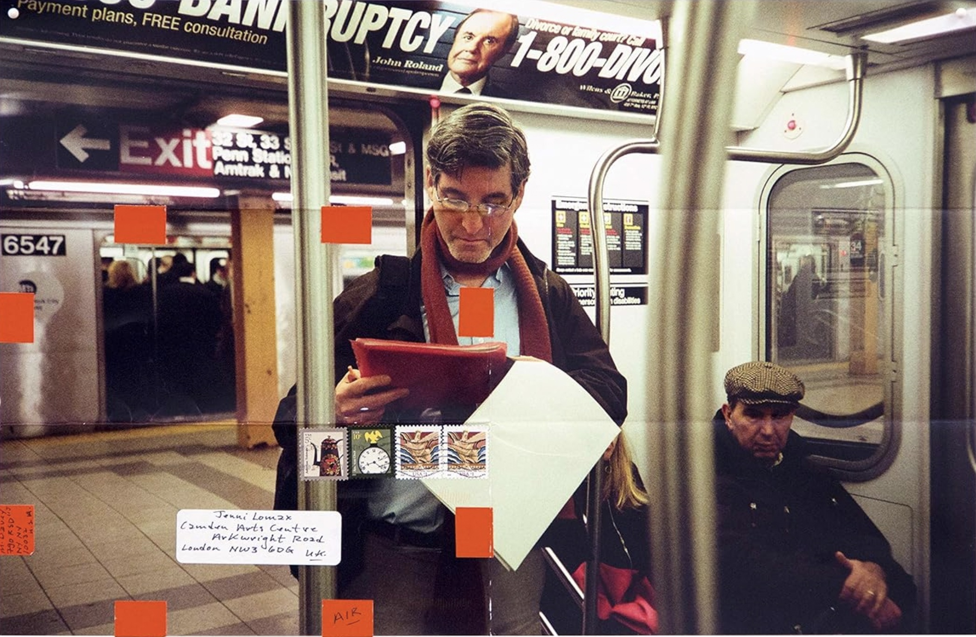

Slide 26
Joiri Minaya (b. 1990) is a Dominican-United Statesian multidisciplinary artist “whose works focus on destabilizing historic and contemporary representations of an imagined tropical identity” (from the artist’s bio published on her website)
She works principally in photography and often incorporates elements of performance as well as original textile designs, based on deep research into indigenous knowledge of and practices of tropical and botanical medicine, the impacts of settler colonialism and genocide/ecocide on local ecosystems, and ideas about tropical places and peoples produced by European exploration and settler colonialism, perpetuated by the conjoined violences of US imperialism, racism, and misogyny.
Minaya’s work can be understood as extending the legacies of feminist conceptual practice in the field of photography while also infusing this practice with approaches drawn from “woman of color” and “Third World” feminisms; critical theories of race; and performance art.

Slide 27
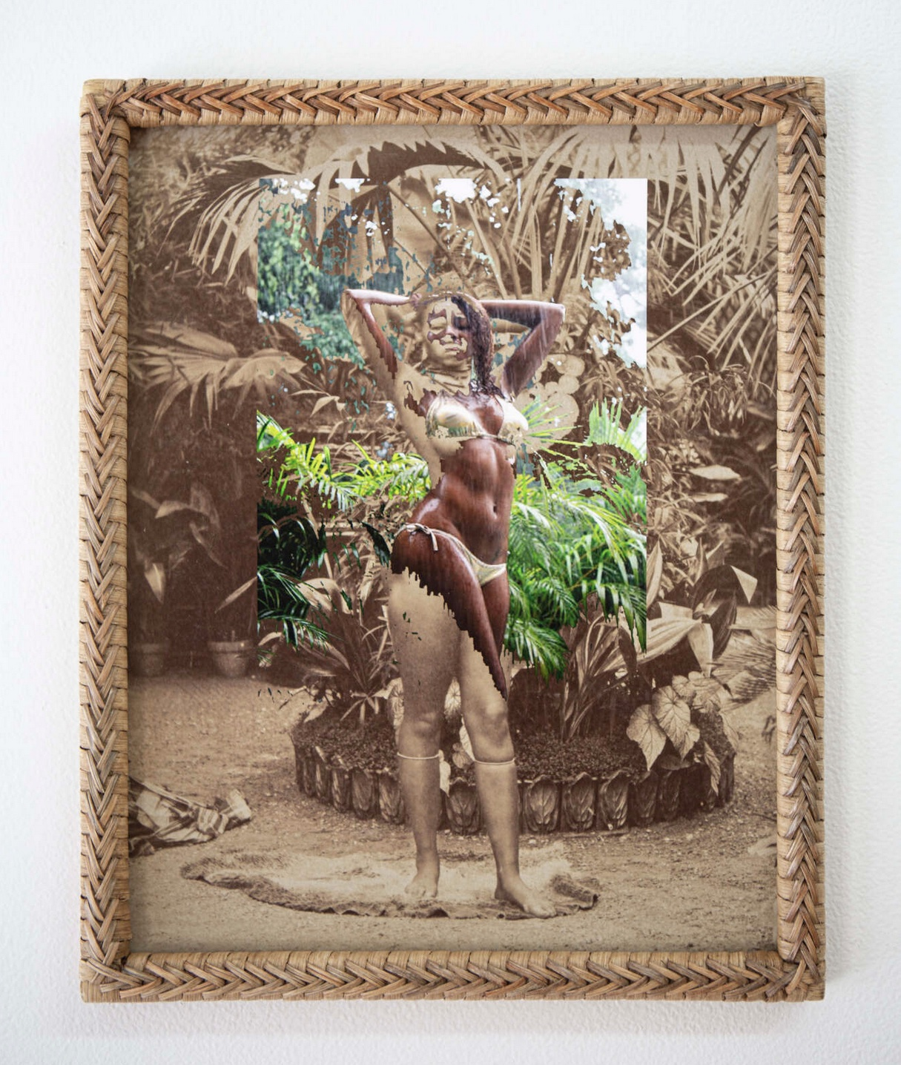

Slide 28
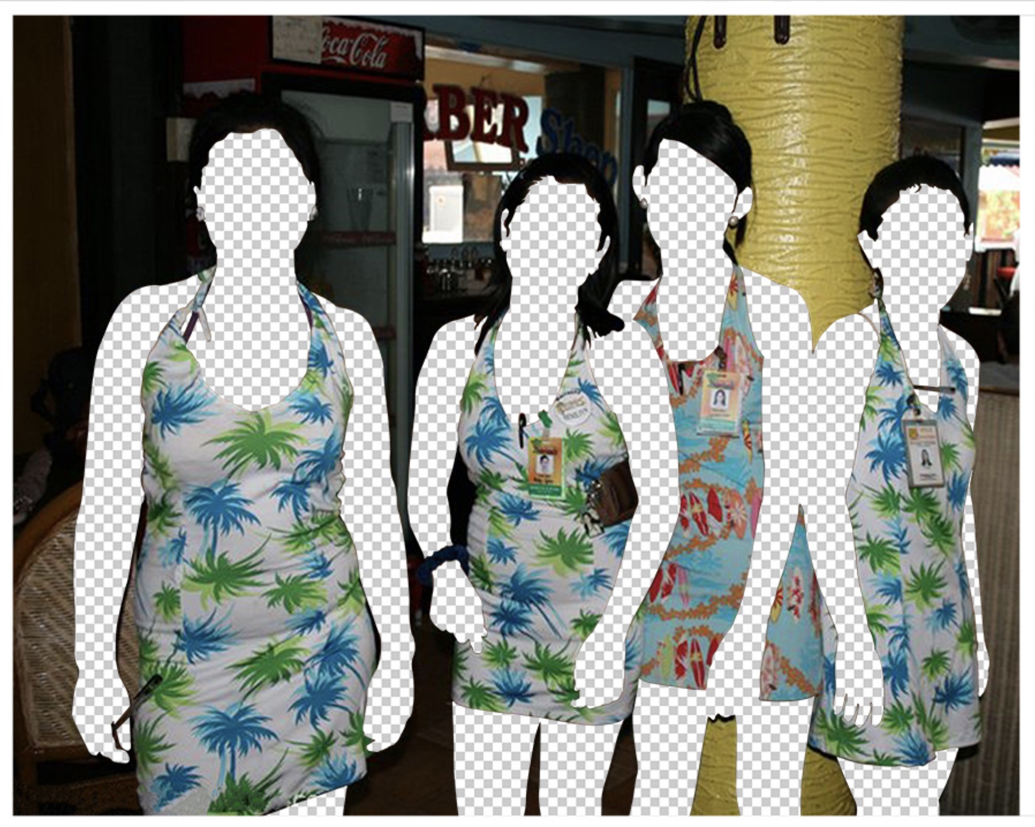

Slide 29
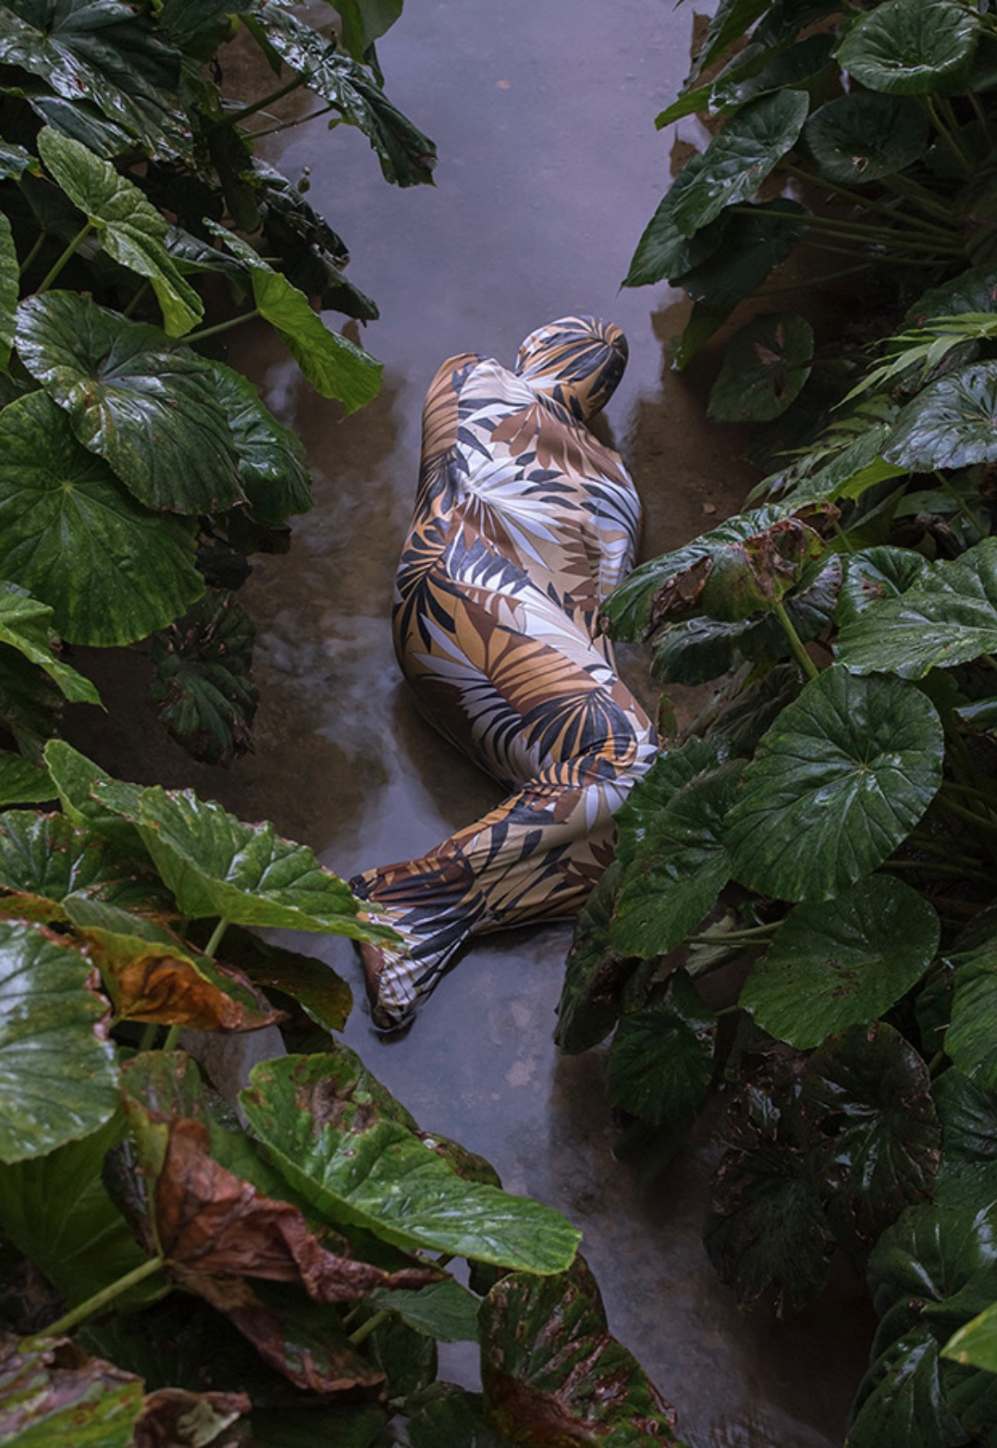

Slide 30
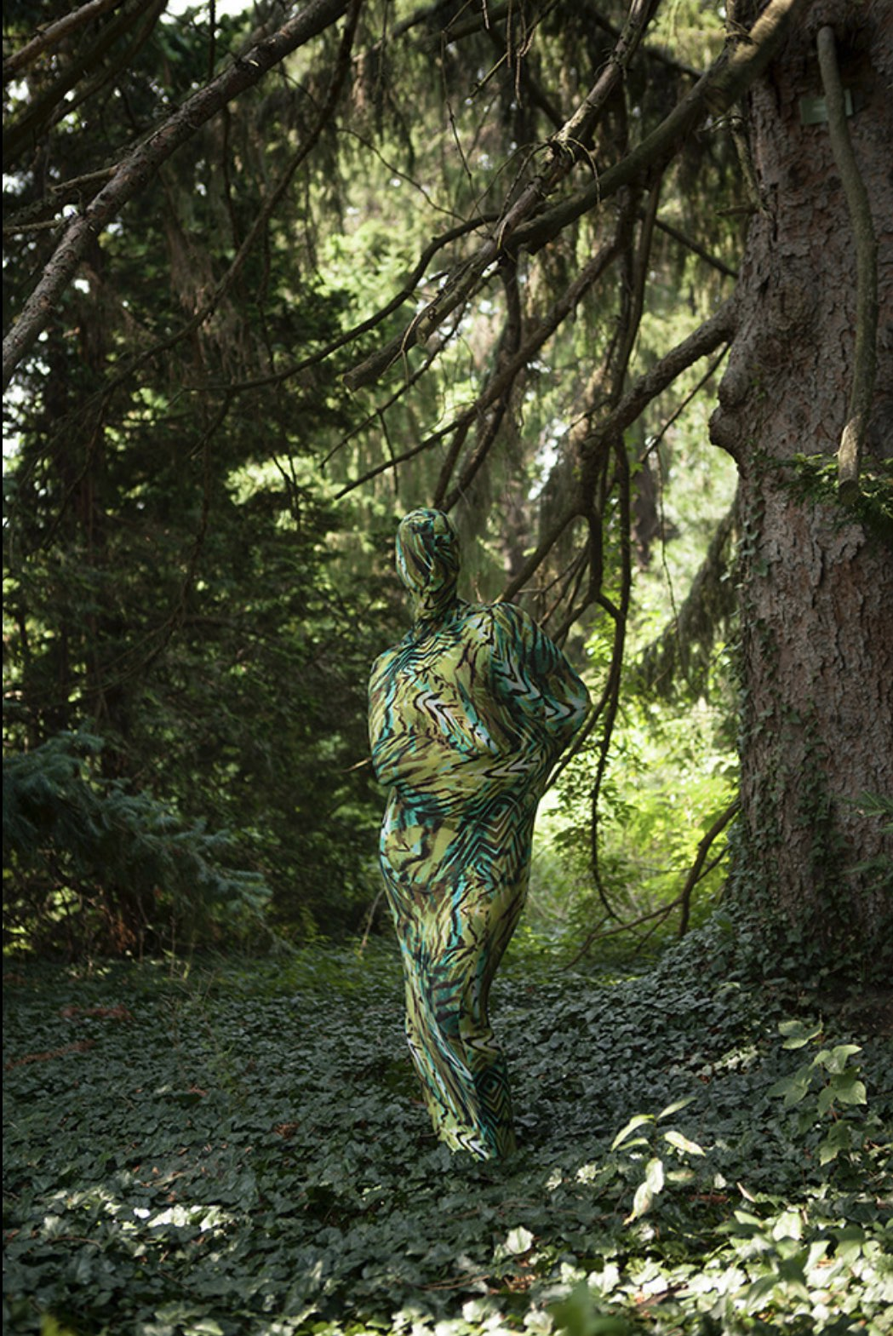

Slide 31
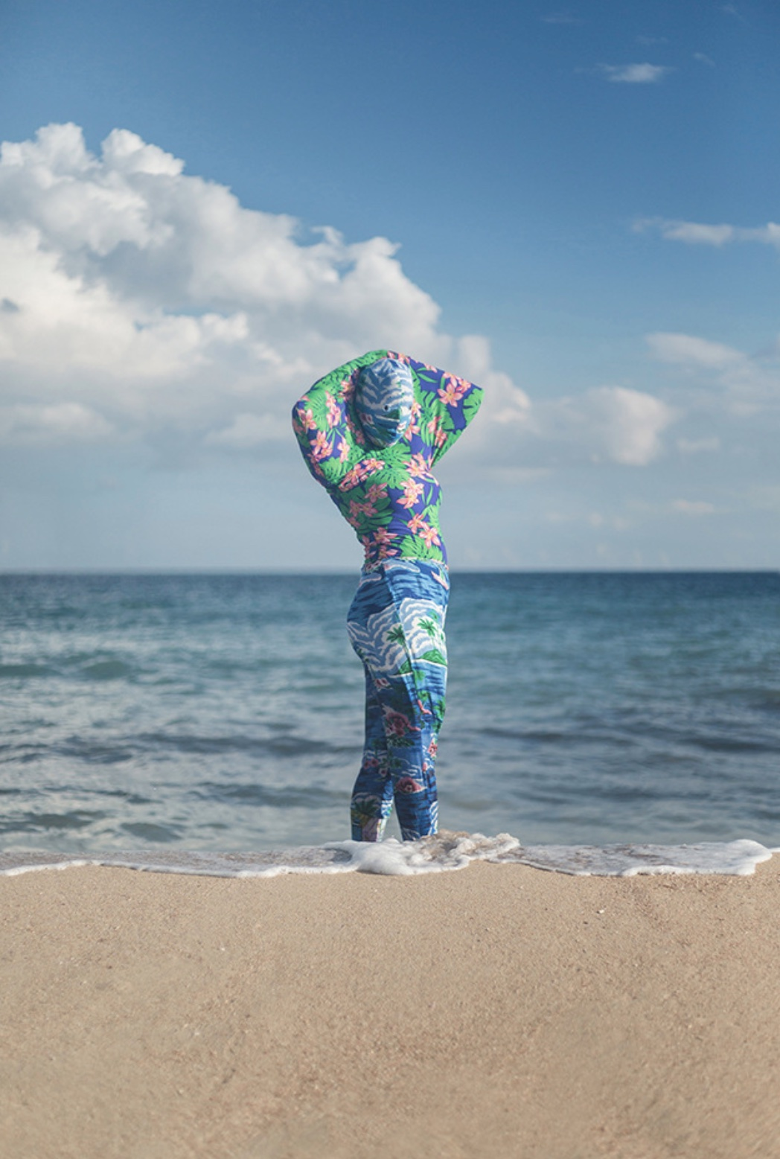

Slide 32
